Slide 1
Placeholder Variables
Programming Concepts Simplified
You will need pen and paper or pen and whiteboard
Terms and conditions of use are on the last slide

Slide 2
Prior Knowledge
Sequence
Repetition
Selection
A simple sequence is one instructions following another
An input is how we put information into a program (keyboard, mouse, trackpad inputs) or digital device
digital devices run programs (oven, kettle, fridge, computer etc)
A loop is a set of instructions that are repeated A count-controlled-loop
Is controlled by the number
Ends after the number of repeats are complete
An indefinite loop
we do not know how many times it will repeat or when it will end
A condition is a state we can check to see if it is true or false
Conditions
Only checked once unless they are in a loop
Two possible pathways True and False
Are only checked when reached in flow of control
Can be used to stop a loop
x7

Slide 3
Variables Defined
Information stored by a digital device
Named unit of data that holds a value
Unique name
Text or Number

Slide 4
Variables are like whiteboards
Buy flowers for Gran
You can write on a whiteboard

Slide 5
Variables are like whiteboards
12
Any type of data, text or numbers

Slide 6
Variables are like whiteboards
Buy flowers for Gran
You can rub out your message

Slide 7
Variables are like whiteboards
text
mum
You can write a new message

Slide 8
Variables are NOT like whiteboards
to_do
name
text
mum
You have to give a variable a name

Slide 9
Variables are NOT like whiteboards
to_do
name
text
mum
value
We call the data written the value

Slide 10
Variables are NOT like whiteboards
to_do
name
text
mum
You have to give a variable a name to identify it in an algorithm or code

Slide 11
Variables
Variables store data that can be used by an algorithm or program
capEngland
London
Numbers
Text
Mixed numbers & text called strings

Slide 12
True of False?
Variables have a name and a value
fav_name
name
Thorfinn
value

Slide 13
True of False?
Variables have a name and a value
fav_name
name
Thorfinn
value
True

Slide 14
Assigning value
fav_name
name
When we link a value to a variable we call it assigning
Michelle
value
I have assigned Michelle to fav_name

Slide 15
Assigning value
fav_name
name
Assign your own value to fav_name?
________
value

Slide 16
Read the name say the value
fav_name loves to dance like a kitten. In my class, fav_name loves to shout out “I love my teacher.” I would love to change my name to fav_name!

Slide 17
1, Choose a variable name
Fav_colour, ageInYears, favNum, best_friend, favAnimal
2, Write a funny sentence that uses the variable
My friends say I look like a favAnimal.
3, Ask your partner to assign a value to the variable
Assign monkey to favAnimal (Don’t let them read your sentence first!)
4, Ask them to read the name say the value
My friends say I look like a monkey.

Slide 18
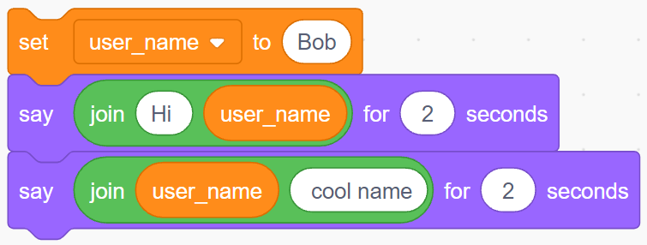
Assign a value to a variable before using it
Scratch uses set to assign a value

Slide 19
What is the name of the variable? What is the name of the value?

Slide 20
What is the name of the variable? What is the name of the value?
Name is user_name
Value is Bob

Slide 21
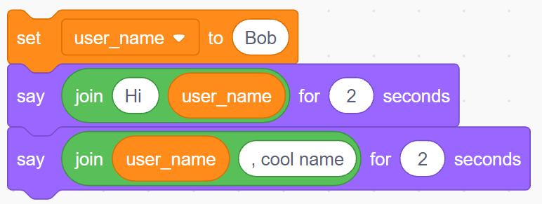
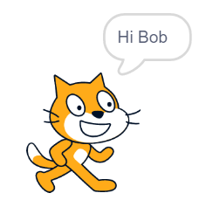
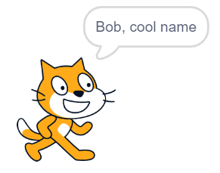
Read the name act on the value

Slide 22
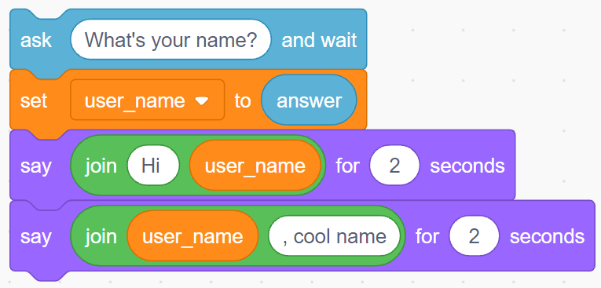
Get user to assign a value to a variable before using it
Use the ask and answer block to get the user to put in their own value

Slide 23
Get user to assign a value to a variable before using it
If the user inputs Lana what will line 3 say when the code is run?
Line 1
Line 2
Line 3
Line 4

Slide 24
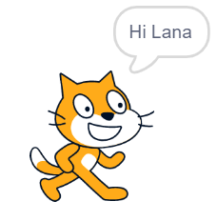
Get user to assign a value to a variable before using it
Line 1
Line 2
Line 3
Line 4

Slide 25
Placeholder variables key knowledge
Variables store data
Variables have a name and a value
Assign a value before using a variable
Read the name act on the value
You can get the user to assign a value to a variable

Slide 26
Placeholder variables further knowledge
Variables can be assigned numbers, text or both (strings)
We name variables without spaces so user name becomes user_name or userName (camel case).
Scratch will allow you to use multiple words in the name but most programming languages will not.
©HIAS

Slide 27
Terms of use
Slides are provided in PDF and PowerPoint Formats and teachers who purchased the book are authorized to adapt the resources within their school or on closed learning platforms such as Seesaw, Google Classroom or Teams as long as they are not shared outside the school community.
Further book resources can be found here
https://computing.hias.hants.gov.uk/course/view.php?id=51

