Slide 1
Simple Procedures
Programming Concepts Simplified
You will need pen and paper or pen and whiteboard
Terms and conditions of use are on the last slide

Slide 2
Prior Knowledge
Sequence
Repetition
Selection
A simple sequence is one instructions following another
An input is how we put information into a program (keyboard, mouse, trackpad inputs) or digital device
digital devices run programs (oven, kettle, fridge, computer etc)
A loop is a set of instructions that are repeated A count-controlled-loop
Is controlled by the number
Ends after the number of repeats are complete
An indefinite loop
we do not know how many times it will repeat or when it will end
A condition is a state we can check to see if it is true or false
Conditions
Only checked once unless they are in a loop
Two possible pathways True and False
Are only checked when reached in flow of control
Can be used to stop a loop
x7

Slide 3
Procedure Defined
Named set of instructions grouped together to control a part of a program

Slide 4
Training a dog to beg
Everyday Procedures
Once you have trained the dog you only need to say beg and the dog will go through all the actions to beg
Notes:
Ask your pupils if they can think of any more
(sleeping is a good one)

Slide 5
Everyday Procedures
Beg
Sit down
Head up
Raise right paw
Hold paw up
Paw down
Notes:
Ask your pupils if they can think of any more
(sleeping is a good one)

Slide 6
Everyday Procedures
Autopilot can fly the plane
fly
The fly button runs a procedure with very complex code to fly the plane
Notes:
Maybe get pupils to order the landing procedure or do it as a whole class.

Slide 7
Two Parts Call Procedure & Procedure
Life Algorithm
Loop always
breathe
Define breathe
Breathe in
Wait
Breathe out
wait
Notes:
Emphasise that the procedures are started from the algorithm on the right. They can be used over and over again. Read the script on the right and reference the procedures on the left.

Slide 8
Two Parts Call Procedure & Procedure
This is the procedure (look for define to find one)
Life Algorithm
Loop always
breathe
Define breathe
Breathe in
Wait
Breathe out
wait
This calls (starts) the procedure by referring to it by name
Notes:
Emphasise that the procedures are started from the algorithm on the right. They can be used over and over again. Read the script on the right and reference the procedures on the left.

Slide 9
Two Parts Call Procedure & Procedure
Life Algorithm
Loop always
if hungry
eat
Define eat
Loop until full
Find food
Put in mouth
chew
swallow
yes
Full?
no
Hungry?
yes
no
Notes:
Emphasise that the procedures are started from the algorithm on the right. They can be used over and over again. Read the script on the right and reference the procedures on the left.

Slide 10
Procedure Question
Life Algorithm
Loop always
if hungry
eat
Define eat
Loop until full
Find food
Put in mouth
chew
swallow
yes
Full?
no
Hungry?
yes
no
What symbol shows procedures in our algorithm?
What symbol shows procedures in our algorithm??
Notes:
Emphasise that the procedures are started from the algorithm on the right. They can be used over and over again. Read the script on the right and reference the procedures on the left.

Slide 11
Procedure Answer
Life Algorithm
Loop always
if hungry
eat
Define eat
Loop until full
Find food
Put in mouth
chew
swallow
yes
Full?
no
Hungry?
yes
no
What symbol shows procedures in our algorithm?
What symbol shows procedures in our algorithm??
Notes:
Emphasise that the procedures are started from the algorithm on the right. They can be used over and over again. Read the script on the right and reference the procedures on the left.

Slide 12
Procedure Question
B
Life Algorithm
Loop always
if hungry
eat
Define eat
Loop until full
Find food
Put in mouth
chew
swallow
yes
Full?
no
Hungry?
yes
no
A
What symbol shows procedures in our algorithm?
Which part calls the procedure A or B?
Notes:
Emphasise that the procedures are started from the algorithm on the right. They can be used over and over again. Read the script on the right and reference the procedures on the left.

Slide 13
Procedure Answer
B
Life Algorithm
Loop always
if hungry
eat
Define eat
Loop until full
Find food
Put in mouth
chew
swallow
yes
Full?
no
Hungry?
yes
no
A
What symbol shows procedures in our algorithm?
Which part calls the procedure A or B? Answer A
Notes:
Emphasise that the procedures are started from the algorithm on the right. They can be used over and over again. Read the script on the right and reference the procedures on the left.

Slide 14
Write your own procedure and call it from outside the procedure
Life Algorithm
Loop always
breathe
Define breathe
Breathe in
Wait
Breathe out
wait
You can use any concepts such as loops and conditions or keep it simple like this one
Notes:
Emphasise that the procedures are started from the algorithm on the right. They can be used over and over again. Read the script on the right and reference the procedures on the left.

Slide 15
Procedure Knowledge
Procedures
Have a name
Are called by using their name
Can be run many times in a programme
Found in My Blocks in Scratch
In Scratch has define first
Notes:
Emphasise that the procedures are started from the algorithm on the right. They can be used over and over again. Read the script on the right and reference the procedures on the left.

Slide 16
Procedure Naming
Procedures Naming
Name a procedure after the task that it does
Avoid naming procedures with spaces
Avoid using the same name as a variable
Notes:
Emphasise that the procedures are started from the algorithm on the right. They can be used over and over again. Read the script on the right and reference the procedures on the left.

Slide 17
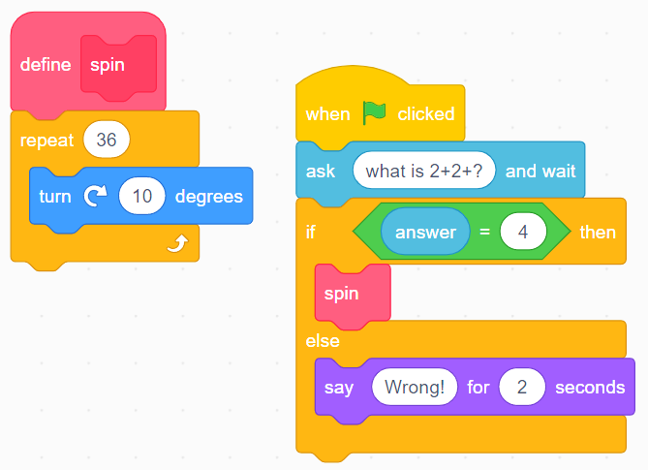
Procedure in Scratch
Main program
Procedure
Command that calls (starts) the procedure
©HIAS

Slide 18
Terms of use
Slides are provided in PDF and PowerPoint Formats and teachers who purchased the book are authorized to adapt the resources within their school or on closed learning platforms such as Seesaw, Google Classroom or Teams as long as they are not shared outside the school community.
Further book resources can be found here
https://computing.hias.hants.gov.uk/course/view.php?id=51

