Slide 1
Condition Ends Loop
Programming Concepts Simplified
Terms and conditions of use are on the last slide

Slide 2
Revising Loops
A loop is a set of instructions that are repeated All loops
Can replace a sequence where there is a pattern.
Have a flow of control
Can be used in an algorithm or in programming
A count-controlled-loop
Is controlled by the number
Ends after the number of repeats are complete
Is called a repeat loop in Scratch programming
An indefinite infinite loop
Is indefinite because we do not know how many times it will repeat or when it will end
stand
loop 4 times
wave
bow
sit
X4

Slide 3
Conditions ends loop
Loop until partner says boo
nod head
wave hand

Slide 4
Conditions ends loop
Loop until partner says boo
nod head
wave hand
Two pathways
Have they said boo?
yes
no

Slide 5
Conditions ends loop
Loop until partner says boo
nod head
wave hand
Have they said boo?
yes
no
Act this out with a partner

Slide 6
Conditions ends loop
Loop until partner claps
move one step forward
move one step backwards
Have they clapped?
yes
no
The loop is stopped by the condition being true

Slide 7
Conditions ends loop
Loop until partner claps
move one step forward
move one step backwards
Have they clapped?
yes
no
It only stops the loop once the flow of control gets back to the condition and it is true

Slide 8
Conditions ends loop
Loop until partner claps
move one step forward
move one step backwards
Have they clapped?
yes
no
Act this out with a partner

Slide 9
Conditions ends loop
Loop until partner claps
move one step forward
move one step backwards
Now write your own and act it out with a partner

Slide 10
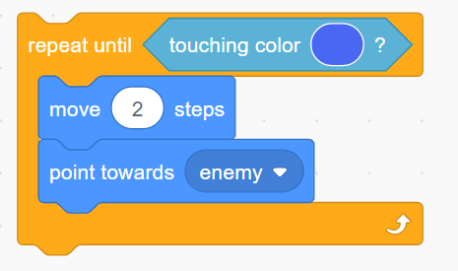
Conditions ends loop
In Scratch Code

Slide 11
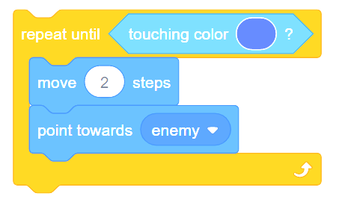
Conditions ends loop
In Scratch Code
Touching blue?
yes
no

Slide 12
Knowledge Summary
A condition is a state we can check to see if it is true or false
Conditions can end loops
Conditions are only checked once unless they are in a loop
Conditions lead to two possible pathways True and False
Conditions are only checked when reached in the flow of control
©HIAS

Slide 13
Terms of use
Slides are provided in PDF and PowerPoint Formats and teachers who purchased the book are authorized to adapt the resources within their school or on closed learning platforms such as Seesaw, Google Classroom or Teams as long as they are not shared outside the school community.
Further book resources can be found here
https://computing.hias.hants.gov.uk/course/view.php?id=51

