Slide 1
Simple Sequence
Programming Concepts Simplified
Terms of use are on the last slide

Slide 2
Simple Sequence
Stand
Wave
Bow
Sit
One thing at a time in an order

Slide 3
Simple Sequence
Stand
Wave
Bow
Sit
Arrows show the order the algorithm takes

Slide 4
Simple Sequence
Stand
Wave
Bow
Sit
Act it out

Slide 5
Simple Sequence
Stand
Wave
Bow
Sit
We all waved differently

Slide 6
Simple Sequence
Stand
Wave once slowly
Bow
Sit
Act it out

Slide 7
Simple Sequence
Stand
Wave once slowly
Bow
Sit
What was different?

Slide 8
Simple Sequence
Stand
Wave once slowly
Bow
Sit
What was different?
More detail telling us how to wave

Slide 9
Simple Sequence
Stand
Wave once slowly
Bow
Sit
Algorithms are easier to follow if they are precise with more detail

Slide 10
Simple Sequence
Stand
Wave once slowly
Bow
Sit
Now write your own and act it out with a partner
Can you make it precise?

Slide 11
Simple Sequence
Stand
Wave once slowly
Bow
Sit
This is the flow of control, the order the algorithm takes

Slide 12
Simple Sequence
Stand
Wave once slowly
Bow
Sit
Dots show actions

Slide 13
Simple Sequence
Stand
Wave once slowly
Bow
Sit
Draw a flow of control next to your algorithm

Slide 14
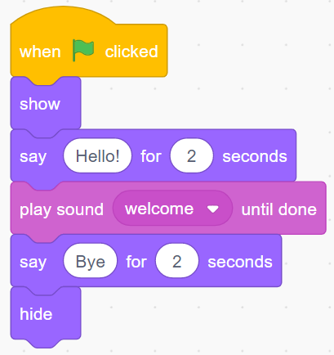
Simple Sequence
Simple sequence in Scratch code

Slide 15
Simple Sequence
Simple sequence in Scratch code with flow of control

Slide 16
Terms of use
Slides are provided in PDF and PowerPoint Formats and teachers who purchased the book are authorized to adapt the resources within their school or on closed learning platforms such as Seesaw, Google Classroom or Teams as long as they are not shared outside the school community.
Further book resources can be found here
https://computing.hias.hants.gov.uk/course/view.php?id=51

