Slide 1
Condition Switches Between Actions
Programming Ideas Simplified
Terms and conditions of use are on the last slide

Slide 2
Revising Loops
stand
loop 4 times
wave
bow
sit
A loop is a set of instructions that are repeated All loops can
Can replace a sequence where there is a pattern.
Has a flow of control
Can be used in an algorithm or in programming
A count-controlled-loop
Is controlled by the number
Ends after the number of repeats are complete
Is called a repeat loop in Scratch programming
An indefinite infinite loop
Is indefinite because we do not know how many times it will repeat or when it will end
X4

Slide 3
Condition-starts-action revision
If you are hungry
put your hand up
Do you remember these?

Slide 4
Condition-switches-between-actions
If you are hungry
put your hand up
Else
Smile sweetly

Slide 5
Condition-switches-between-actions
If you are hungry
put your hand up
Else
Smile sweetly
The action is indented to show that the action only happens if the condition is met / true
This action is indented to show that the action only happens if the condition is NOT met / false

Slide 6
Acts like a switch
If you are hungry
put your hand up
Else
Smile sweetly
If and else act like a switch if the condition is true if the condition is false
It can never be both it is either true of false

Slide 7
Condition-switches-between-actions
stand
If you like drawing
bow slowly
Else
wave
Sit
Act out this everyday algorithm

Slide 8
Condition-switches-between-actions
stand
If you like drawing
bow slowly
Else
wave
Sit
What actions are NOT affected by the condition?

Slide 9
Condition-switches-between-actions
stand
If you like drawing
bow slowly
Else
wave
Sit
What actions are NOT affected by the condition?

Slide 10
Condition-switches-between-actions
stand
If you like drawing
bow slowly
Else
wave
Sit
What actions are affected by the condition?

Slide 11
Condition-switches-between-actions
stand
If you like drawing
bow slowly
Else
wave
Sit
What actions are affected by the condition?

Slide 12
Condition-switches-between-actions
stand
If you like drawing
bow slowly
Else
wave
Sit
How many times will the condition be checked?

Slide 13
Condition-switches-between-actions
stand
If you like drawing
bow slowly
Else
wave
Sit
How many times will the condition be checked?
Once only

Slide 14
Condition-switches-between-actions
If you like drawing
bow slowly
Else
wave
Now write your own everyday algorithm that uses condition switches between actions
Can your neighbour act it out?
One mark if it makes sense
One mark if each section is on a new line
One mark if you indent the actions

Slide 15
Flow of control
stand
If you like drawing
bow slowly
Else
wave
Sit
Dots show actions
Diamond shows the condition
Blue path is one you take if you do NOT like drawing
Orange path is one you take if you DO like drawing
Everyone sits at the end

Slide 16
Flow of control
Laugh loudly
If you like programming
wave
tap head
Else
groan loudly once
Do 3 times
lift both arms
lower both arms
Act out this everyday algorithm

Slide 17
Flow of control
Laugh loudly
If you like programming
wave
tap head
Else
groan loudly once
Do 3 times
lift both arms
lower both arms
Draw the flow of control. Do not forget to draw the count controlled loop at the bottom

Slide 18
Flow of control
Laugh loudly
If you like programming
wave
tap head
Else
groan loudly once
Do 3 times
lift both arms
lower both arms
Line at top (1 mark)
Two dots on one side only (1 mark)
One dot on other side (1 mark)
Loop line (1 mark)
3x (1 mark)
Two dots in loop(1 mark)
Loop is left with arrow (1 mark)
3x

Slide 19
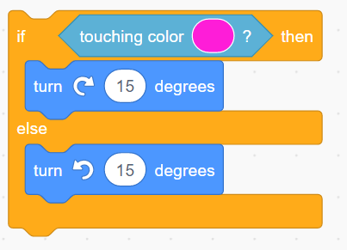
Condition-switches-between-actions in code

Slide 20
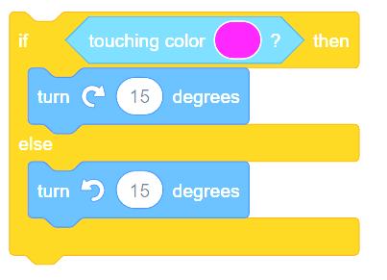
Condition-switches-between-actions in code

Slide 21
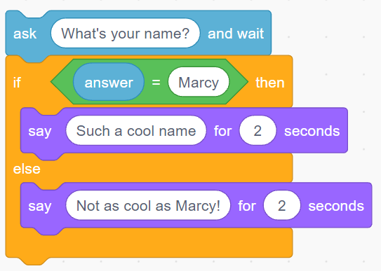
Condition-switches-between-actions in code

Slide 22
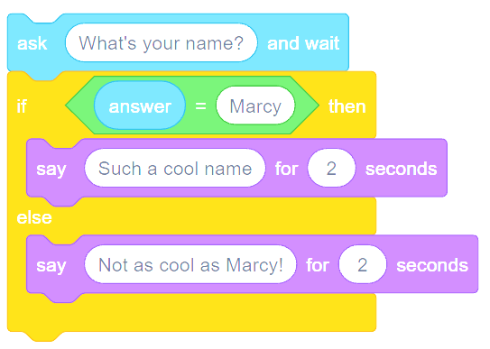
Condition-switches-between-actions in code

Slide 23
Conditional Selection Knowledge
A condition is a state we can check to see if it is true or false
Conditions
Starts with an if
Only checked once unless they are in a loop
Two possible pathways True and False
Are only checked when reached in flow of control
Actions can be started by conditions being true or false
©HIAS

Slide 24
Terms of use
Slides are provided in PDF and PowerPoint Formats and teachers who purchased the book are authorized to adapt the resources within their school or on closed learning platforms such as Seesaw, Google Classroom or Teams as long as they are not shared outside the school community.
Further book resources can be found here
https://computing.hias.hants.gov.uk/course/view.php?id=51

