Slide 1
Condition Starts Action
Programming Ideas Simplified
Terms and conditions of use are on the last slide

Slide 2
Revising Loops
stand
loop 4 times
wave
bow
sit
A loop is a set of instructions that are repeated All loops
Can replace a sequence where there is a pattern.
Have a flow of control
Can be used in an algorithm or in programming
A count-controlled-loop
Is controlled by the number
Ends after the number of repeats are complete
Is called a repeat loop in Scratch programming
An indefinite infinite loop
Is indefinite because we do not know how many times it will repeat or when it will end
X4

Slide 3
Everyday condition-starts-action
If you are rude again
I am taking away your Gameboy
Have you heard things like this?
If you work hard
You can have a treat

Slide 4
Everyday condition-starts-action
If you do that once more
I am telling your mother
Tell your partner about any you have heard
If you finish tea
We can watch something on TV

Slide 5
Everyday condition-starts-action
If you work hard
You can have a treat

Slide 6
Everyday condition-starts-action
If you are hungry
rub your tummy
The action is indented to show that the action only happens if the condition is met / true

Slide 7
Everyday condition-starts-action
If you are hungry
rub your tummy
Roleplay this everyday algorithm

Slide 8
Everyday condition-starts-action
Smile
Frown
If you like cooking
wave your hand once
Tap head once
Roleplay this everyday algorithm

Slide 9
Everyday condition-starts-action
Smile
Frown
If you like cooking
wave your hand once
Tap head once
What actions are affected by the condition

Slide 10
Everyday condition-starts-action
Smile
Frown
If you like cooking
wave your hand once
Tap head once
What actions are affected by the condition
Because it is indented

Slide 11
Everyday condition-starts-action
Smile
Frown
If you like cooking
wave your hand once
Tap head once
What actions are not affected by the condition

Slide 12
Everyday condition-starts-action
Smile
Frown
If you like cooking
wave your hand once
Tap head once
What actions are not affected by the condition
Because they are NOT indented

Slide 13
Everyday condition-starts-action
Smile
Frown
If you like cooking
wave your hand once
Tap head once
How many times is the condition checked?

Slide 14
Everyday condition-starts-action
Smile
Frown
If you like cooking
wave your hand once
Tap head once
How many times is the condition checked?
Once only

Slide 15
Everyday condition-starts-action
Smile
Frown
If you like cooking
wave your hand once
Tap head once
Now write your own everyday algorithm that uses condition-starts-action
One mark if it makes sense
One mark if each section is on a new line
One mark if you indent the actions
Can your neighbour act it out?

Slide 16
Flow of control
Dots show actions
Diamond shows the condition
Blue path is one you take if you do NOT like cooking
Orange path is one you take if you do like cooking
Everyone taps head once at the end
Smile
Frown
If you like cooking
wave your hand once
Tap head once

Slide 17
Flow of control
Wave once
If you like programming
smile
tap head
Do 3 times
nod head
Roleplay this everyday algorithm

Slide 18
Flow of control
Wave once
If you like programming
smile
tap head
Do 3 times
nod head
Draw the flow of control. Do not forget to draw the count controlled loop at the bottom

Slide 19
Flow of control
Wave once
If you like programming
smile
tap head
Do 3 times
nod head
Line at top (1 mark)
Two dots on one side only (1 mark)
Loop line (1 mark)
3x (1 mark)
Dot in the loop (1 mark)
3x

Slide 20
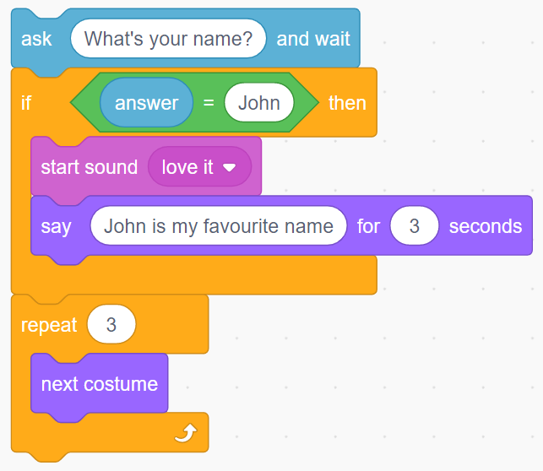
Condition-starts-action in code
Action
Condition
Action
Action
Action

Slide 21
Flow of control in code
3x

Slide 22
Knowledge Summary
A condition is a state we can check to see if it is true or false
Conditions
Starts with an if
Only checked once unless they are in a loop
Two possible pathways True and False
Are only checked when reached in flow of control
©HIAS

Slide 23
Terms of use
Slides are provided in PDF and PowerPoint Formats and teachers who purchased the book are authorized to adapt the resources within their school or on closed learning platforms such as Seesaw, Google Classroom or Teams as long as they are not shared outside the school community.
Further book resources can be found here
https://computing.hias.hants.gov.uk/course/view.php?id=51

