Slide 1
Part 2 Fast & Slow Actions
Terms of use are on the last slide

Slide 2
Actions a computer processes per second
Computers process millions of instructions a second

Slide 3
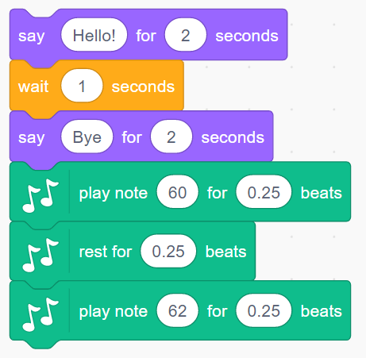
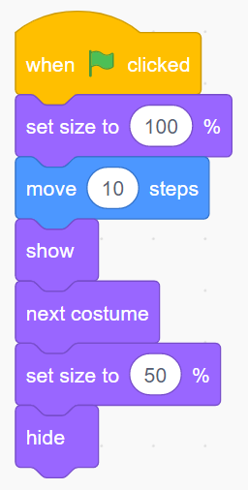
Fast & Slow
Slow over 5 seconds
Fast millions of commands per second
Slow over 0.75 beats

Slide 4
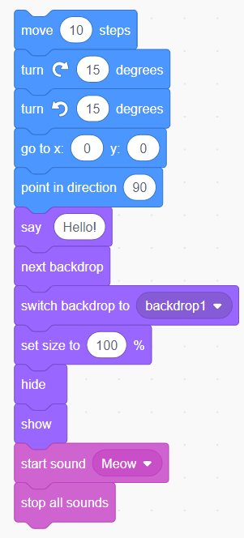
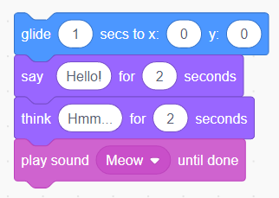
Fast & Slow
Fast millions of commands per second
Slow over 5 seconds
What is different between these fast & slow blocks?

Slide 5
Fast & Slow
Fast millions of commands per second
Slow over 5 seconds
Slow blocks have times or say until done

Slide 6
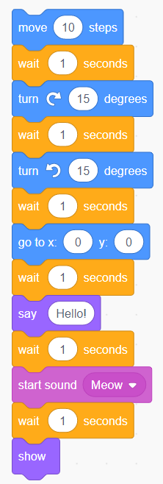
Fast & Slow
Fast millions of commands per second
Fast
Slow
Fast blocks can be slowed down by wait blocks
Fast
Slow
Fast
Slow
Fast
Slow
Fast
Slow
Fast
Slow
Fast

Slide 7
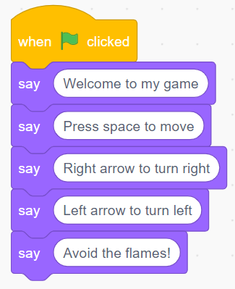
Fast & Slow
What is wrong with this code?

Slide 8
Fast & Slow
What is wrong with this code?
No waits or times

Slide 9
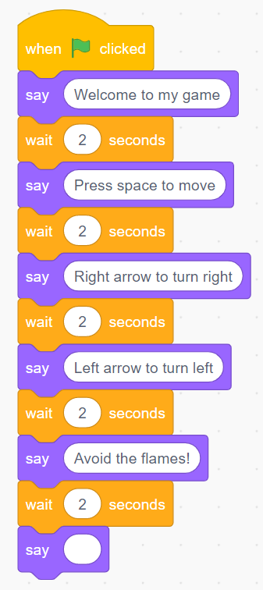
Fast & Slow
Fixed

Slide 10
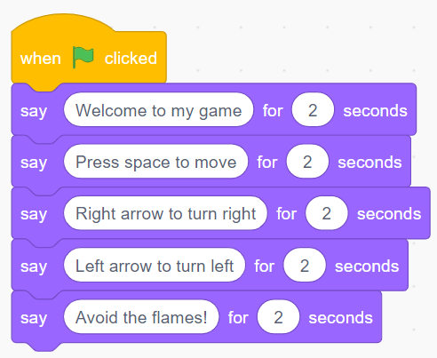
Fast & Slow
Fixed

Slide 11
Timing Matters in Programming
Look out for blocks with built in times and blocks without

Slide 12
Terms of use
Slides are provided in PDF and PowerPoint Formats and teachers who purchased the book are authorized to adapt the resources within their school or on closed learning platforms such as Seesaw, Google Classroom or Teams as long as they are not shared outside the school community.
Further book resources can be found here
https://computing.hias.hants.gov.uk/course/view.php?id=51

