Slide 1
Conditions Inside Loops
Programming Concepts Simplified
Terms and conditions of use are on the last slide

Slide 2
Revising Loops
stand
loop 4 times
wave
bow
sit
A loop is a set of instructions that are repeated All loops can
Can replace a sequence where there is a pattern.
Has a flow of control
Can be used in an algorithm or in programming
A count-controlled-loop
Is controlled by the number
Ends after the number of repeats are complete
Is called a repeat loop in Scratch programming
An indefinite infinite loop
Is indefinite because we do not know how many times it will repeat or when it will end
X4

Slide 3
Revising Condition Starts Action
If partner touches shoulder
wave hand
Do you remember these?

Slide 4
Revising Condition Starts Action
Stand
If partner waves once
Bow
clap
Sit
Two pathways

Slide 5
Revising Condition Starts Action
Stand
If partner waves once
Bow
clap
Sit
Conditions start with if

Slide 6
Revising Condition Starts Action
Stand
If partner waves once
Bow
clap
Sit
Actions started by a condition are indented

Slide 7
Revising Condition Starts Action
Stand
If partner waves once
Bow
clap
Sit
Conditions are only checked once

Slide 8
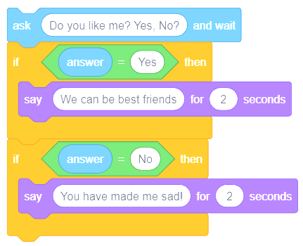
Revising Condition Starts Action
In Scratch Code

Slide 9
Conditions starts action inside loop
Loop always
if touch shoulder
turn right 90 degrees

Slide 10
Conditions starts action inside loop
Loop always
if touch shoulder
turn right 90 degrees
Condition is checked many times because of the loop

Slide 11
Conditions starts action inside loop
Loop always
if touch shoulder
turn right 90 degrees
Work with a partner to act this out

Slide 12
Conditions starts action inside loop
Always loop
if partner clap
jump once
bow once
A condition can start many actions

Slide 13
Conditions starts action inside loop
Always loop
if partner clap
jump once
bow once
Work with a partner to act this out

Slide 14
Conditions starts action inside loop
Always loop
if partner clap
jump once
bow once
Try it out with a partner
Now write your own

Slide 15
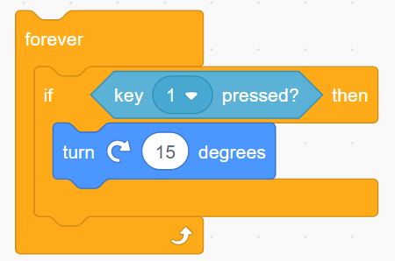
Conditions starts action inside loops
In Scratch Code

Slide 16
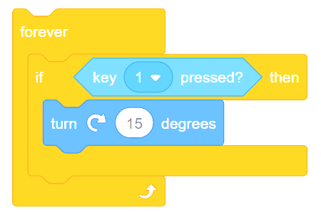
Conditions starts action inside loops
In Scratch Code

Slide 17
Shapes game act it out
Always loop
if touching circle
hum
Loop always
if touching square
wave

Slide 18
Shapes game write your own
Always loop
if________________
then_________

Slide 19
Task Level Planning
What will your game do?
Keep it short
Examples
Bob will have to go through the maze without touching anything. If he touches the maze walls or enemies he will go back to the start.
You have to steer crab to find food. Shark will swim and try and catch crab. If crab gets food the food will disappear.
Dancer has to dance away from other dancers who dance in patterns. If dancer hits other dancers the game ends. There will be music.

Slide 20
Design Level Planning
Draw a picture of the screen (stick people NOT art work)
Where will characters start on the screen? Initialisation

Slide 21
Design Level Planning
What objects / characters will your game have?
List all things each object will do?
Bob
Move forward space key
Steer right, right arrow key
Steer left, left arrow key
If hit enemies move you back to the start
Enemies
Move on a set path
Start position
Maze gate
Move back and forwards
Crab
Move forwards
Steer right button
Steer left button
If hit shark end game
Shark
Move forwards slowly
Point towards crab
Dancer
Up arrow point up move up
Down arrow point down move down
Right arrow point right move right
Left arrow point left move left
Other dancers
Move on set route
Start position
New dancers add after time

Slide 22
Design Level Planning
Algorithm writing
Loop always
if 1 key pressed
move 10 steps
Bob
Move button
Steer right button
Steer left button
If hit enemies back to start
Enemies
Glide to in loop
Start position
Loop always
if right arrow key pressed
turn right
Loop always
if bot touch enemies
back to start x and y
©HIAS

Slide 23
Terms of use
Slides are provided in PDF and PowerPoint Formats and teachers who purchased the book are authorized to adapt the resources within their school or on closed learning platforms such as Seesaw, Google Classroom or Teams as long as they are not shared outside the school community.
Further book resources can be found here
https://computing.hias.hants.gov.uk/course/view.php?id=51

